Slide 1
Task list tutorial

Slide 2
In this exercise, you will create a small task list application
The idea is that you can create small tasks, containing data:
Creater
Task description
Time of creation
It contains three views (only one will be shown at a time)
Add new task
View all tasks
Get next task
It will use the MVVM and observer pattern.

Slide 3
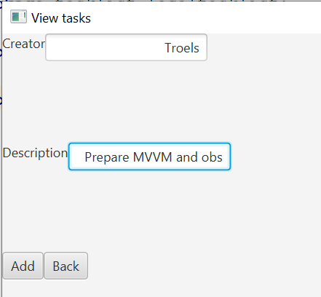
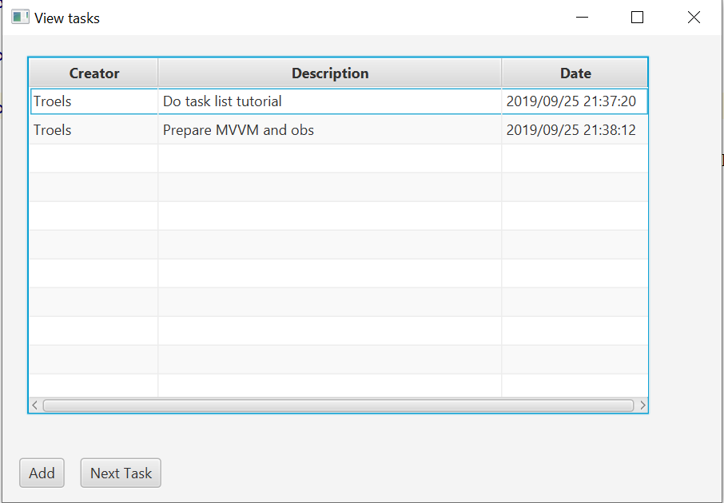
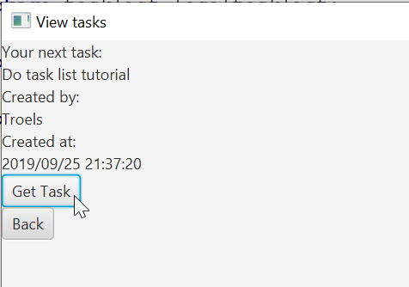
The result will look something like this
View to get the next task
View to create tasks
View to see list of all tasks. These are sorted by creation time

Slide 4
The result will look something like this
Get/remove next task from the list
Back to view all tasks
Adds task
Back to view all tasks
Open add task view
Open next task view

Slide 5
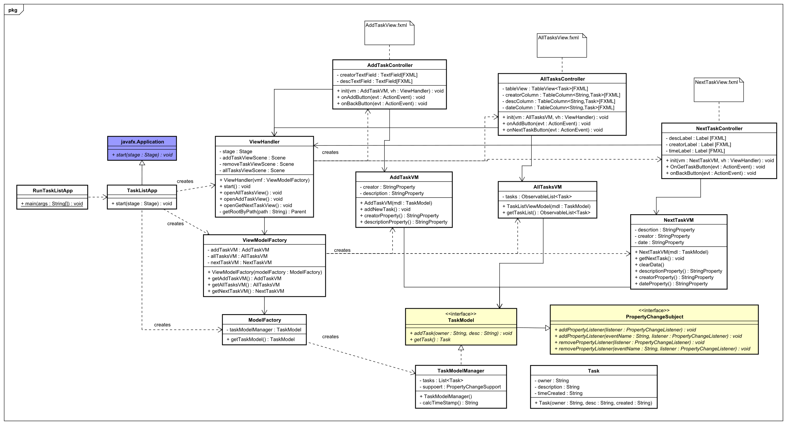
This is a rough UML diagram Interfaces marked yellow Existing java class marked purple

Slide 6
This class exists in JavaFX, you don’t create it
Creates and changes views
This class starts everything with its main method
This class creates stuff and calls start() on the ViewHandler to get everything started
ModelFactory creates the TaskModel
ViewModelFactory creates the View models

Slide 7
FXML files to define the GUI
FXML files to define the GUI
FXML files to define the GUI

Slide 8
FXML files to define the GUI
Controller classes behind the fxml files
FXML files to define the GUI
View models.
FXML files to define the GUI
FXML files to define the GUI

Slide 9
Interface from observer session
Model containing our data
Data container, to hold task information

Slide 10
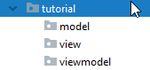
So let’s begin the implementation.
Create a package to contain this exercise. I suggest a package structure like so (without classes)
Or just create a structure, you’re comfortable with.
I have grouped mine by “category”, so all view models are in the same package.
It could also make sense to group by feature, e.g.:
TaskList
model
addtasks
AddTaskController
AddTaskViewModel
AddTaskView.fxml
alltasks
AllTasksController
AllTasksViewModel
AllTasksView.fxml

Slide 11
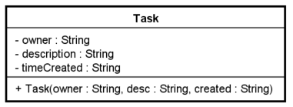
We need to start somewhere, and it’s often to create the class with no dependencies first, and then move your way backward.
The only class in the exercise, with no outgoing associations or dependencies, is the Task. We create this first.
Put it in the ‘model’ package
It must have the fields and methods according to the UML
Also create get methods
This is our data container, and is meant to only contain data, without any logic. These are the type of objects which may be sent around in a SEP project

Slide 12
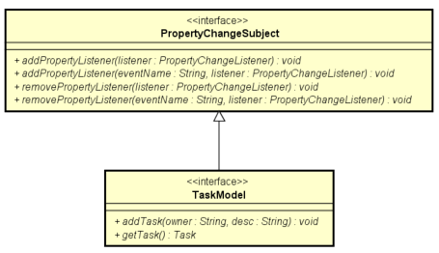
The Model
The TaskList interface is the next step. It only depends on the Task object.
Create this interface, put it in the ‘model’ package
The PropertyChangeSubject interface is the one from the Observer session. We want our model to be observable, so whenever a task is added or removed, our views can show the updated information correctly.
We want to be able to put tasks into our model. And also to retrieve tasks

Slide 13
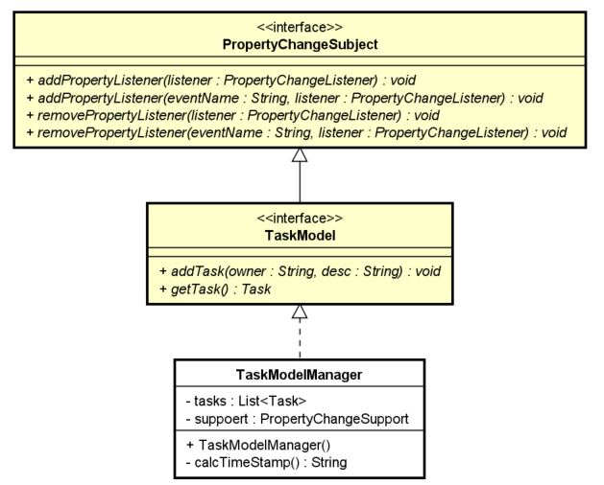
And finally we create the model implementation. In our exercise here, the model knows nothing about any of the classes using it.
It is a subject, so whenever something changes, it will notify interested Listeners.
Otherwise its main functionality is just to hold, provide access to, and manipulate our data.
The TaskModelManager implements the TaskModel interface, so all methods noted in TaskModel and PropertyChangeSubject must be implemented in the TaskModelManager

Slide 14
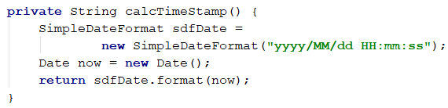
Instantiate the tasks variable in the constructor
Instantiate the PropertyChangeSupport in the constructor
The addTask method creates a new task object and adds it to the list (use calcTimeStamp)
The getTask method removes the first task in the list and returns it.
The calcTimeStamp method is given by
It creates a Data of this current moment, and formats it according to the string, to make it look nice
Also implement the add and remove methods from the PropertyChangeSubject, so that you add/remove listeners to the support

Slide 15
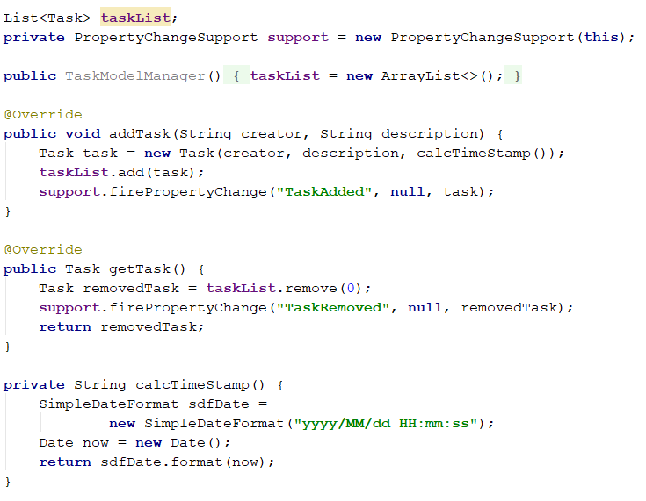
Now the model should be in place. It should similar to
List of all Tasks
Support to notify listeners
Using calcTimeStamp to get a nicely formatted time
Creating a new Task
Fire event, that a new Task was added. I use null, because the previous value is not interesting here
Removing first task of list
Fire event, that a Task was removed.
Method to calculate and format a time

Slide 16
We have created this part:

Slide 17
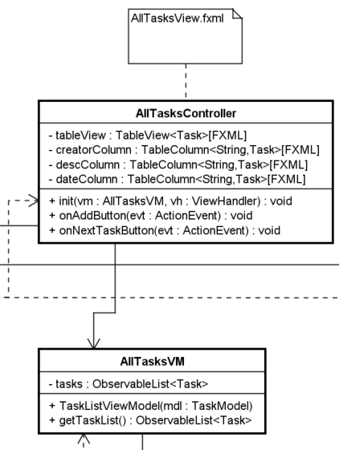
The next step is to create the View which can display all Tasks.
This requires the fxml file, the controller behind it, and the view-model.
The dependencies goes downward, so it’s easier to create the AllTasksVM first. This class only depends on the TaskModel interface, which we already have.
This view will show a list of all tasks in our model.
It’s for viewing only, we can not edit or modify anything through this view.

Slide 18
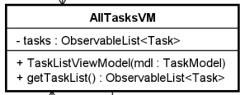
Create the class AllTasksVM in an appropriate package.
The constructor takes as argument the TaskModel, i.e. our model interface. It’s good practice to separate different ‘layers’ of our system with interfaces. It makes for loose couplings.
You can create the ObservableList in the constructor using
The ObservableList is just like an ArrayList, except that it is also a subject, which can notify when elements are added or removed. Many JavaFX UI elements use the ObservableLists, because we can databind it, so that we get the automated updates.
This list will contain the data, which is presented in the View. According to the theory, the View-model should hold the data, which is shown in the View.

Slide 19
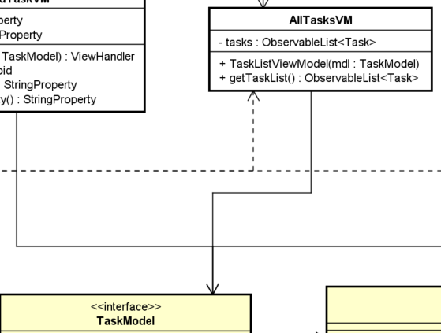
Notice that our View-model has an association to the TaskModel, which means that the TaskModel you get through the constructor, should be put in a field variable. This variable is not shown in the ‘AllTasksVM’ box to the left, because it is implied by the arrow to TaskModel

Slide 20
You also need to the View model as a listener of the TaskModel
You could use the shorthand lambda expression to call private methods
The View-model must listen for both events, which can be fired from the model.
When a Task added, you get this task from the PropertyChangeEvent, it’s the new value. Add it to the tasks-list
When a Task is removed, you get this task from the PropertyChangeEvent, and then call to remove it from the list.

Slide 21
Your AllTasksVM should look similar to this:
Reference to our model.
public class AllTasksVM { private TaskModel model; private ObservableList<Task> tasks; public AllTasksVM(TaskModel model) { this.model = model; tasks = FXCollections.observableArrayList(); model.addPropertyChangeListener("TaskAdded", this::listModified); model.addPropertyChangeListener("TaskRemoved", evt -> tasks.remove((Task) evt.getNewValue())); } private void listModified(PropertyChangeEvent evt) { tasks.add((Task) evt.getNewValue()); } public ObservableList<Task> getTaskList() { return tasks; } }
Creating a new ObservableArrayList
When ‘TaskAdded’ event is received, call method ‘listModified
Adding listeners
To illustrate alternative approach, just use lambda to inline functionality.
Here I remove the received task from the list
Get method, so the Controller can retrieve the list and use it in the tableView

Slide 22
Our AllTasksVM is now listening to changes in the model and reacting accordingly.
When a task from another view is added to the model, the AllTasksVM is notified with this latest task, so that it can also be displayed in the task overview.
When a task is removed from the model, the AllTasksVM is notified, so it can remove that task from the overview.
Let’s do the fxml file

Slide 23
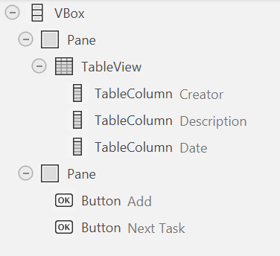
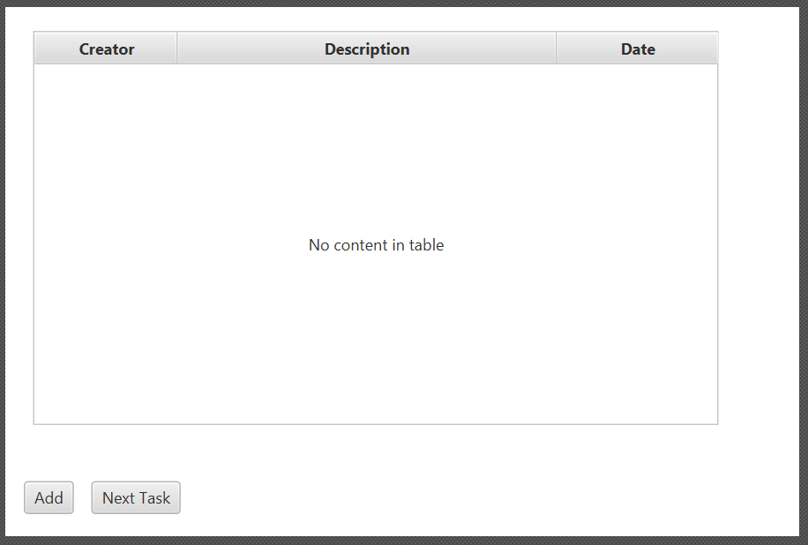
We want to display the tasks overview using a TableView. It’s good for showing attributes of a list of objects.
My scene structure looks like this:
And the GUI:
Try to set it up similarly

Slide 24
You need to add various fxml tags to the elements of the GUI so we can access these from the Controller class.
The ‘Creator’ column should have the fx:id ‘creatorColumn’
The ‘Description’ column should have the fx:id ‘descColumn’
The ‘Date’ column should have fx:id ‘dateColumn’
The Add button doesn’t need an fx:id, because I don’t need to reference it from the Controller class. However, it must have On Action specified, which is the method that will be called, when this button is clicked. You can call this ‘onAddButton’, or something that makes sense to you.
Similarly for the Next Task button, give it an On Action.
Save everything, inspect it in IntelliJ/Eclipse

Slide 25
Your fxml should look similar to the below.
Mostly it’s just about heights and widths, not too interesting.
Verify you have the three TableColumn tags, nested inside the TableView tag
Next slide
<VBox maxHeight="-Infinity" maxWidth="-Infinity" minHeight="-Infinity" minWidth="-Infinity" prefHeight="400.0" prefWidth="600.0" xmlns="http://javafx.com/javafx/10.0.1" xmlns:fx="http://javafx.com/fxml/1" fx:controller="tasklist.tutorial.view.alltasks.AllTasksController"> <children> <Pane prefHeight="351.0" prefWidth="600.0"> <children> <TableView fx:id="tableView" layoutX="21.0" layoutY="18.0" prefHeight="298.0" prefWidth="518.0"> <columns> <TableColumn fx:id="creatorColumn" editable="false" prefWidth="107.33333778381348" text="Creator" /> <TableColumn fx:id="descColumn" editable="false" prefWidth="286.66664123535156" text="Description" /> <TableColumn fx:id="dateColumn" prefWidth="122.66665649414062" text="Date" /> </columns> </TableView> </children> </Pane> <Pane prefHeight="65.0" prefWidth="600.0"> <children> <Button layoutX="14.0" layoutY="15.0" mnemonicParsing="false" onAction="#onAddButton" text="Add" /> <Button layoutX="65.0" layoutY="15.0" mnemonicParsing="false" onAction="#onNextTaskButton" text="Next Task" /> </children> </Pane> </children> </VBox>

Slide 26
Notice the red AllTasksController, you probably need to add this. It could be done from the SceneBuilder too. It’s red because the class cannot be found, we haven’t created it yet.
Similarly, the onAddButton and onNextTaskButton are red, again because these methods cannot be found, in the class that doesn’t exist yet.
<VBox maxHeight="-Infinity" maxWidth="-Infinity" minHeight="-Infinity" minWidth="-Infinity" prefHeight="400.0" prefWidth="600.0" xmlns="http://javafx.com/javafx/10.0.1" xmlns:fx="http://javafx.com/fxml/1" fx:controller="tasklist.tutorial.view.alltasks.AllTasksController"> <children> <Pane prefHeight="351.0" prefWidth="600.0"> <children> <TableView fx:id="tableView" layoutX="21.0" layoutY="18.0" prefHeight="298.0" prefWidth="518.0"> <columns> <TableColumn fx:id="creatorColumn" editable="false" prefWidth="107.33333778381348" text="Creator" /> <TableColumn fx:id="descColumn" editable="false" prefWidth="286.66664123535156" text="Description" /> <TableColumn fx:id="dateColumn" prefWidth="122.66665649414062" text="Date" /> </columns> </TableView> </children> </Pane> <Pane prefHeight="65.0" prefWidth="600.0"> <children> <Button layoutX="14.0" layoutY="15.0" mnemonicParsing="false" onAction="#onAddButton" text="Add" /> <Button layoutX="65.0" layoutY="15.0" mnemonicParsing="false" onAction="#onNextTaskButton" text="Next Task" /> </children> </Pane> </children> </VBox>

Slide 27
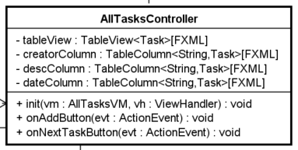
So let’s create the AllTasksController.
Create the field variables as shown. Mark them with @FXML (I have [FXML] to indicate this) So that the javafx framework will put the GUI elements in to these variables for us. The variable name must match the fx:id specified in the fxml file.
Next slide

Slide 28
Create the init method, in which you receive the ViewHandler. Put this in a field variable. Again, this is not shown in the image to the right, because the arrow in the uml indicates the association.
We haven’t created this class yet, so it’ll be red for now. We’ll fix it shortly.
We’ll do our bindings here. It’s a bit complicated because of the TableView, so I’ll show the code on the next slide.

Slide 29
In the init method put the following
These are used to define which data to show in the table
Each column takes a PropertyValueFactory
These are the columns
creatorColumn.setCellValueFactory(new PropertyValueFactory<>("creator")); descColumn.setCellValueFactory(new PropertyValueFactory<>("description")); dateColumn.setCellValueFactory(new PropertyValueFactory<>("date")); tableView.setItems(vm.getItemsList());
I know my table contains Task objects, and here I give the name of the variable, which should be shown in the column. You must match this name to the name of the variable in the Task object. Case sensitive
Here we get the ObservableList from the View-model, and put it into the tableView. The table view will then display what’s in the list. Because the list is observable, whenever the content changes, the table view will automatically update

Slide 30
Leave the methods
onAddButton
onNextTaskButton
Empty for now.
When we have the ViewHandler class, we will make a call to it here, to make it swap views.

Slide 31
The AllTaskController should look like
Table columns. The <String, Task> says that the column will show a String value, taken from a Task object.
TableView, variable name identical to what is specified in fxml
public class AllTasksController { @FXML private TableView<Task> tableView; @FXML private TableColumn<String, Task> creatorColumn; @FXML private TableColumn<String, Task> descColumn; @FXML private TableColumn<String, Task> dateColumn; private ViewHandler viewHandler; public void init(AllTaskVM vm, ViewHandler vh) { this.viewHandler = vh; creatorColumn.setCellValueFactory(new PropertyValueFactory<>("creator")); descColumn.setCellValueFactory(new PropertyValueFactory<>("description")); dateColumn.setCellValueFactory(new PropertyValueFactory<>("date")); tableView.setItems(vm.getTaskList()); } public void onAddButton(ActionEvent actionEvent) { } public void onNextTaskButton(ActionEvent actionEvent) { } }
Specifying what is shown in the table view
The data is held in the View-model, here we make the table view show it
Empty methods for now. Will be filled in, when we have the ViewHandler

Slide 32
So now we have the red part
We’ll proceed with the blue to test run it

Slide 33
First the ModelFactory. Again we go backwards with the associations. We already have everything this class depends on.
It just has a field variable of type TaskModel
And a get method to lazy instantiate this.

Slide 34
The ModelFactory
Lazy instantiation is used to only create something, when we actually need it
Probably overkill to have the ModelFactory. But we practice the template, and in SEP you may need multiple models. It’s very convenient to have a class responsible for creation. It ensures that all View-models accesses the same instance of a model class, instead of separate.
public class ModelFactory { private TaskModel taskModel; public TaskModel getTaskModel() { if(taskModel == null) taskModel = new TaskModelManager(); return taskModel; } }
Lazy instantiation may be overkill here

Slide 35
Next the ViewModelFactory.
The constructor takes a ModelFactory, and stores in a field variable.
For now just create a get method for the AllTasksVM.
Lazy instantiation, similar to the previous slide.
We’ll add the other two get methods later, when we need them

Slide 36
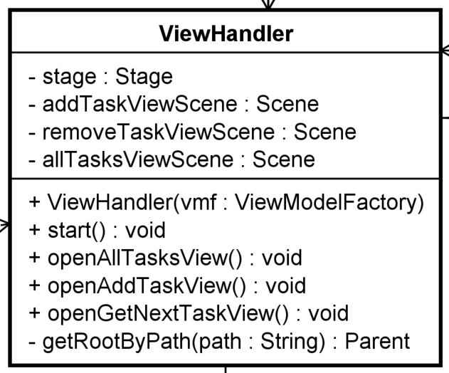
The Scene contains a view. We store it here to reuse, similar to the state.
Now the ViewHandler.
Each stage is a separate window. We want only one window, so we will reuse the state. Therefore we store it as a field
You could have one method, which takes a parameter specifying which view to open. We’ll try multiple methods here. To test your preference
This method is used to load fxml files into Parent objects.

Slide 37
Create the ViewHandler class
Create the field variables
Define the methods, leave them empty for now, we’ll fill them in step by step
Once the ViewHandler class is created, go to the AllTaskController to import it, so the compile error is fixed.
Also, in the two on… methods, call on the ViewHandler the relevant method. Either ‘openAddTaskView’ or ‘openGetNextTaskView’
Have you thought about where you’ve put your classes so far?

Slide 38
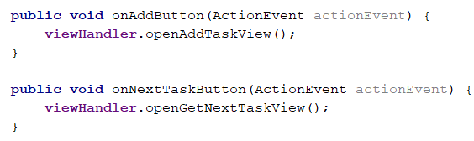
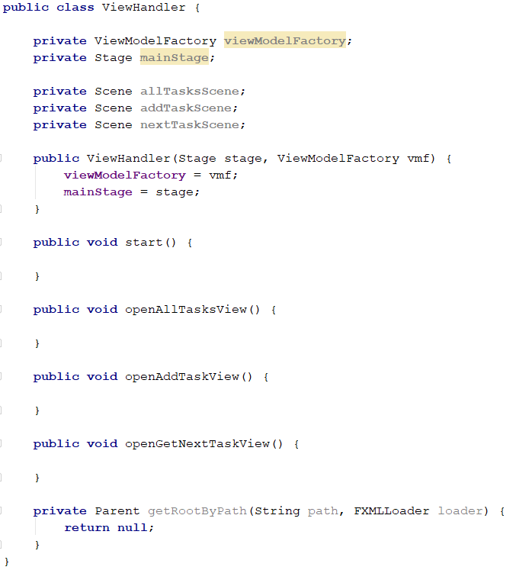
In the AllTaskController:
And the ViewHandler for now:
References to the scenes. To be reused every time a view is reopened.
mainStage as field variable, to be able to reuse it

Slide 39
Now that we’ve created the ViewHandler, lets just finish it.
This class is responsible for creating, managing and changing the views.
It often makes it easier to have this functionality centralized in one class.
You avoid creating the same View from multiple places, risking having multiple instances.
You can reuse the load fxml code.
You know where the responsibility is, if opening/closing a view misbehaves. You don’t need to look through various classes for it.

Slide 40
The method to load fxml looks like this
Specify where the fxml is located
We pass the loader, it will contain the Controller afterwards.
private Parent getRootByPath(String path, FXMLLoader loader) { loader.setLocation(getClass().getResource(path)); Parent root = null; try { root = loader.load(); } catch (IOException e) { e.printStackTrace(); } return root; }
Load the fxml, resulting in a Parent instance, containing all the GUI elements

Slide 41
The method for opening the AllTasksView will then be:
We again use lazy instantiation
public void openAllTasksView() { FXMLLoader loader = new FXMLLoader(); if(allTasksScene == null) { Parent root = getRootByPath("alltasks/AllTasksView.fxml", loader); AllTasksController controller = loader.getController(); controller.init(viewModelFactory.getAllTasksVM(), this); allTasksScene = new Scene(root); } mainStage.setTitle("View tasks"); mainStage.setScene(allTasksScene); }
Extra note (maybe for future potential use):
Sometimes views should be reset when being closed/changed out. We could have all Controllers implement an interface with a reset() method. We have a field variable of this interface type. Before we set the scene of the main stage, we call reset on the interface, and update the interface to be the latest controller.
Initializing the Controller
Setting the the scene, i.e. changing view.

Slide 42
We now have what we need in the ViewHandler. We’re close to be able to run the program.
Call the openAllTasksView() method from the start method of ViewHandler. Thus, when the program starts, this is the view which will be shown.
We need the class which extends application. Next slide.

Slide 43
Create the following class:
public class TaskListApp extends Application { @Override public void start(Stage stage) throws Exception { ModelFactory mf = new ModelFactory(); ViewModelFactory vmf = new ViewModelFactory(mf); ViewHandler vh = new ViewHandler(stage, vmf); vh.start(); } }
A Factory should only ever be created once. We do it here, to make sure it’s only created once. Later we will take a look at the Singleton design pattern, which will ensure this.
We set up all the dependencies, by dependency injection, i.e. giving a class what it needs through its constructor
We start the show by calling our start method on the ViewHandler. This will open the initial view. In our case it’s All Tasks View. Often it could be a login screen or similar.

Slide 44

Now we just need our main method:
Run this main method, and hopefully you should see your view.
This was where I realized, I needed this code at the end of the ViewHandler::start() method
public class RunTaskListApp { public static void main(String[] args) { Application.launch(TaskListApp.class); } }
mainStage.show();

Slide 45
Currently nothing is shown in the table view. Let’s quickly create a test.
Add the following to your TaskListApp::start method:
Running the program now, you should see a new task added to the view every 2.5 seconds
@Override public void start(Stage stage) throws Exception { ModelFactory mf = new ModelFactory(); ViewModelFactory vmf = new ViewModelFactory(mf); ViewHandler vh = new ViewHandler(stage, vmf); vh.start(); Thread thread = new Thread(() -> { TaskModelManager taskModel = (TaskModelManager)mf.getTaskModel(); for(int i = 0; i < 10; i++) { try { Thread.sleep(2500); } catch (InterruptedException e) {} taskModel.addTask("MyName", "Test task " + i); } }); thread.setDaemon(true); thread.start(); }

Slide 46
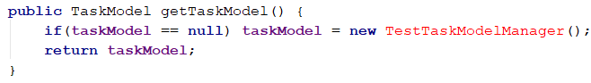
A side note.
Because almost everything in my system just knows about the TaskModel interface, but not the implementation, I could easily swap out the TaskModelManager class with a test class.
This would just require a minor modification in the ModelFactory class:
Next slide

Slide 47
Then the entire system would use my TestTaskModelManager instead. In this class I could create the thread, which adds tasks, instead of doing this in the start method of the TaskListApp class. It would keep my ‘test code’ contained.
The benefit of the interface is that it is easier to swap out classes and functionality. If all classes depended on TaskModelManager instead of TaskModel, I would have to modify arguments and field variables all across. With this, it’s changing one line of code.
In your SEP2, your model may be quite complex (and depend on a client-server connection). One student could work on the GUI/VM part, another on the model part. You would then agree upon the interface and its methods. If the student doing the GUI/VM finishes before the other, or needs to test functionality, (s)he may create a dummy model, implementing the same interface, providing some dummy data. Just to check that when the model fires an event, and the data is then accurately shown in the views.
When the real model is in finished, you can then easily swap it out, by modifying the ModelFactory class. Without requiring modifications elsewhere.

Slide 48
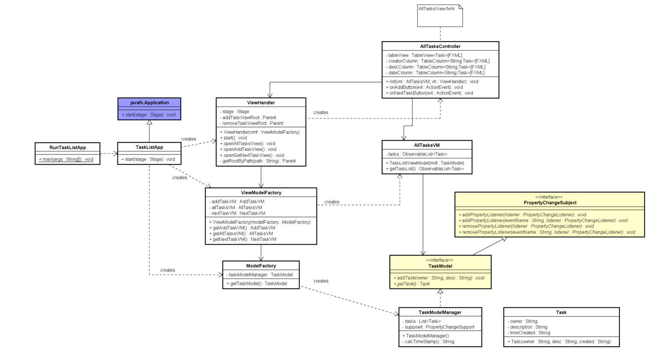
This is now our current system. The thread (1) from the TaskListApp updates the TaskModeManager (2).
The AllTaskVM listens to changes in the TaskModel. Whenever such a change occurs (3), the VM updates its own internal data. This data is then shown/updated in the GUI, by the AllTasksController (4)
The next step is to let the user add tasks. This will again make the TaskModel notify listeners, which will update the AllTask view.
(4)
(1)
(3)
(2)

Slide 49
The next step is to let the user create new tasks.
We have our existing system in place, and hopefully we don’t need to modify much of the existing code. That’s at least the intention of MVVM.
We’re going to need three new files:
An fxml file for the GUI
A controller class behind it
And a ViewModel
We’ll start with the ViewModel.
Often, it may actually be easier to do everything top-down, i.e. first fxml file, then controller, then view model. This follows a more natural flow of creating from user point of view, and then continuing on to whatever you need to make it work.
We’re doing bottom up approach, because I have a somewhat clear plan for us. It will require less jumps back and forth between classes to fix compile errors.

Slide 50
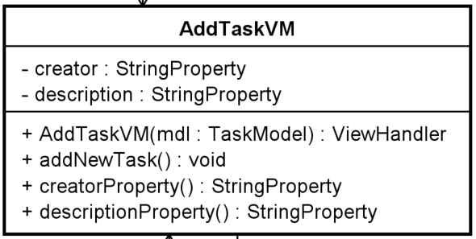
So, the AddTaskViewModel. We already have the functionality in the Model to add tasks, so we’ll just use this.
We’ll need two String properties to hold the data from the user:
Name of creator
Description of task
The time stamp is appended from the model
Instantiate these properties int the constructor.
Then the creatorProperty and descriptionProperty methods, they should just return the relevant properties.
Next the addTask method, next slide

Slide 51
To reiterate, the View-model holds the data shown in the view.
So our two StringProperties contain the data from the view, whatever the user types in. They automatically contain this data because we will databind to them from the controller class. So when a user types something into a text field, the text is also put into our properties here.
Next slide

Slide 52
When we want to add a new task to the model, we just retrieve the data from the StringProperties.
We could first do the input validation, and check they are non-empty. I’ll leave that to you, if you want to implement that.
Take the data, and call the appropriate method on the model.
You’re also going to need a clear() method, I forgot that in the UML. It should just set the values of both properties to “”

Slide 53
Your AddTaskViewModel:
String properties to hold the data shown in the GUI
public class AddTaskVM { private StringProperty description, creator; private TaskModel model; public AddTaskVM(TaskModel model) { description = new SimpleStringProperty(); creator = new SimpleStringProperty();
this.model = model; } public void addTask() { model.addTask(creator.getValue(), description.getValue()); } public StringProperty descriptionProperty() { return description; } public StringProperty creatorStringProperty() { return creator; } public void clear() { description.setValue(""); creator.setValue(""); } }
Reference to the model
Method to be called from the
Get methods for the properties, so that the controller can bind to them
Method to reset the data.
You could call this from the addTask method above

Slide 54
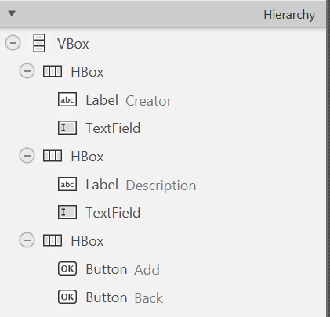
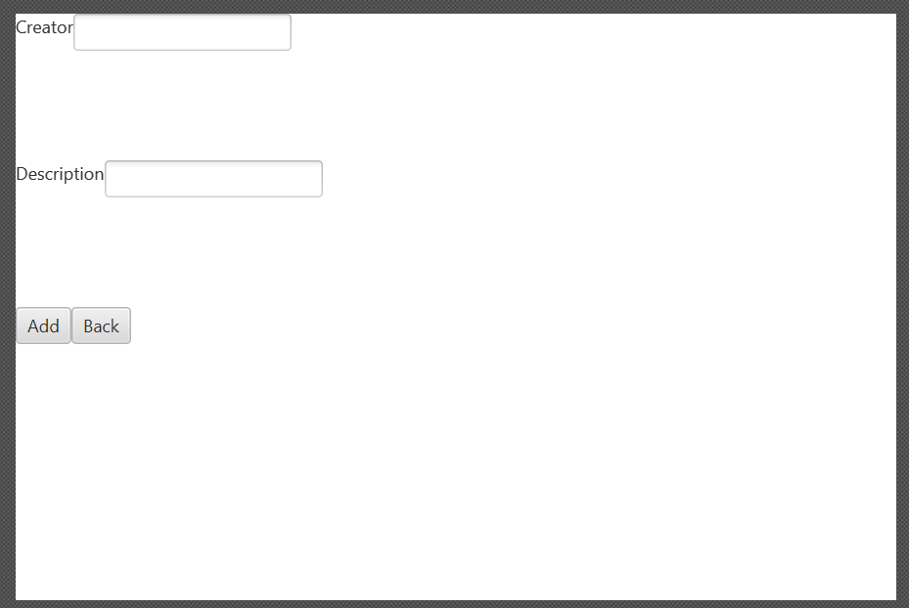
We have the ViewModel in place, and just need the GUI and Controller.
Let’s just do the GUI first.
For my version, I’ve used an approach I call “minimum effort”. It looks like this:

Slide 55
Again, we need fx:id for the two TextFields. I’ve called mine
creatorTextField
descTextField
We also need On Action for both buttons. I’ve used the method names:
onAddAction
onBackAction
The idea is, that I can insert my name in the creator field. And a task description in the description field.
Then click Add, which will add the task to the model. The model will fire events, and update my table view in the other view.

Slide 56
Here’s my fxml
Again, the Controller class is red, because we haven’t created it yet
<VBox maxHeight="-Infinity" maxWidth="-Infinity" minHeight="-Infinity" minWidth="-Infinity" prefHeight="400.0" prefWidth="600.0" xmlns="http://javafx.com/javafx/10.0.1" xmlns:fx="http://javafx.com/fxml/1" fx:controller="tasklist.tutorial.view.addtask.AddTaskController"> <children> <HBox prefHeight="100.0" prefWidth="200.0"> <children> <Label text="Creator" /> <TextField fx:id="creatorTextField" alignment="CENTER_RIGHT" /> </children> </HBox> <HBox prefHeight="100.0" prefWidth="200.0"> <children> <Label text="Description" /> <TextField fx:id="descTextField" alignment="CENTER_RIGHT" /> </children> </HBox> <HBox prefHeight="100.0" prefWidth="200.0"> <children> <Button mnemonicParsing="false" onAction="#onAddAction" text="Add" /> <Button mnemonicParsing="false" onAction="#onBackAction" text="Back" /> </children> </HBox> </children> </VBox>
Same with the method names
witness

Slide 57
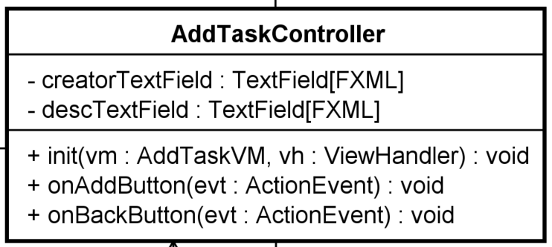
Let’s do the controller class now.
We need the field variables, named identical to the fx:ids in the fxml file.
Mark them both with @FXML
We need the init method. Store the ViewHandler and AddTaskVM in field variables.
In the init method, bind the textfield’s property to the properties from the AddTaskVM.
In the onAddButton, call the relevant method on the AddTaskVM.
In the onBackButton, call the clear method on AddTaskVM. Then ask the ViewHandler to change view.
When clicking back button, we could check the data, and ask the user to confirm that they may discard unsaved changes. The Controller would ask the View-model, if it is allowed to change view before actually changing.

Slide 58
The AddTaskController code:
References to viewHandler and viewModel
References to the TextFields. Named identically to the fx:id in the fxml
public class AddTaskController { @FXML TextField creatorTextField; @FXML TextField descTextField; private ViewHandler viewHandler; private AddTaskVM viewModel; public void init(AddTaskVM vm, ViewHandler vh) { viewHandler = vh; viewModel = vm; creatorTextField.textProperty().bindBidirectional(vm.creatorStringProperty()); descTextField.textProperty().bindBidirectional(vm.descriptionProperty()); } public void onAddAction(ActionEvent actionEvent) { viewModel.addTask(); viewModel.clear(); } public void onBackAction(ActionEvent actionEvent) { viewModel.clear(); viewHandler.openAllTasksView(); } }
Bind bidirectional, so that user input is sent to VM, and the VM can clear the data. Data flows both ways
When the Add button is clicked, we ask the viewModel to save the data, then clear it
When the Back button is clicked, we clear the data, and ask the viewHandler to change view. Here we could ask the viewModel if we’re allowed to change, and maybe we require to confirm that we discard unsaved changes

Slide 59
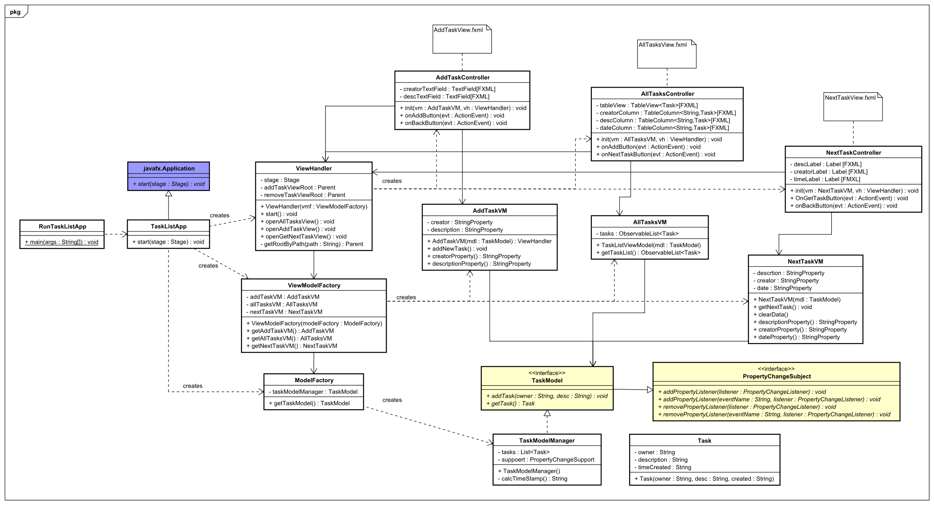
We have the new functionality in place. We’ve completed this now:
We just need to modify the ViewHandler a little bit
And provide a get method for the AddTaskVM

Slide 60
First the ViewModelFactory. Create a get method to return the AddTaskVM. Again with the lazy instantiation.

Slide 61
The ViewHandler.
We need to be able to open the AddTaskView. The method is already called from the AllTasksController, but currently does nothing.
It should do something very similar to the openAllTasksView. Give it a try. Or check the solution on next slide.

Slide 62
The change to ViewHandler::openAddTaskView
Specifying the path to the view fxml
Again, with the lazy instantiation, so we only need to load the view once
public void openAddTaskView() { FXMLLoader loader = new FXMLLoader(); if(addTaskScene == null) { Parent root = getRootByPath("addtask/AddTaskView.fxml", loader); AddTaskController controller = loader.getController(); controller.init(viewModelFactory.getAddTaskVM(), this); addTaskScene = new Scene(root); } mainStage.setTitle("Add task"); mainStage.setScene(addTaskScene); }
Setting the name of the window
Putting the new scene into the mainstage, thereby remove the previous, and showing the new

Slide 63
You should now be able to run your main method, and use the program.
You can add tasks through one view, and see them in an overview in another. And you can switch between the two.
You cannot yet remove tasks from the application.
That’s the next part

Slide 64
This part, you will do by yourself.
We have this, so far:
You just need to create the NextTaskView.fxml
NextTaskController
NextTaskVM

Slide 65
In the NextTask GUI, you can click a button “Next Task”.
The first task in the model should be removed, and then shown in your Gui.
Remember to fire appropriate events, so that the AllTaskView is updated.
Remember to update the ViewModelFactory, and the ViewHandler.
Good luck.

